Slide 1
Introduction to Shiny Introduction to Data Science
Joseph N Paulson
paulson.joseph@gene.com
Several slides modified from Garrett Grolemund / Rstudio

Slide 2
What is Shiny?
Shiny is an R package developed by RStudio that allows one to create interactive websites and visualizations.
Overview:
http://shiny.rstudio.com/
Gallery:
http://shiny.rstudio.com/gallery/
Documentation:
http://shiny.rstudio.com/articles/
http://shiny.rstudio.com/reference/shiny/
Deployment:
http://shiny.rstudio.com/deploy/
Cheat sheet:
Link here
For this presentation, shiny is not a shiny art installation

Slide 3
Examples
A few examples we will go over (Lots of examples in the gallery)
Simple
Malnutrition visualization example – Github Code
http://shiny.rstudio.com/gallery/single-file-shiny-app.html
http://shiny.rstudio.com/gallery/kmeans-example.html
Slightly more advanced
Diarrheal microbiome cohort – Github Code
http://shiny.rstudio.com/gallery/movie-explorer.html

Slide 4
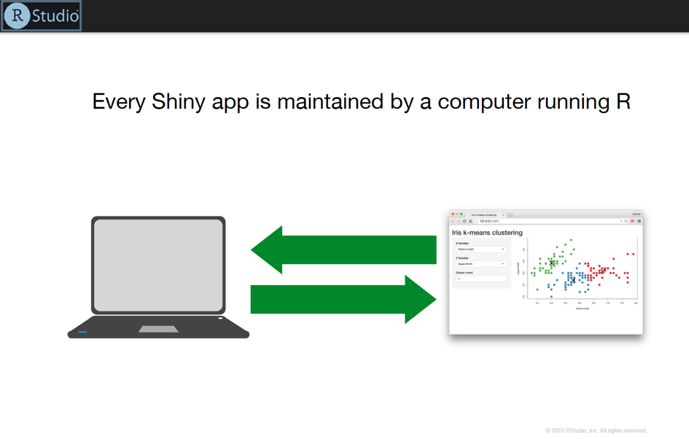
Shiny overview
Every Shiny app is maintained by a computer (laptop, desktop or server) running R
Slides modified / borrowed from Garrett Grolemund

Slide 5
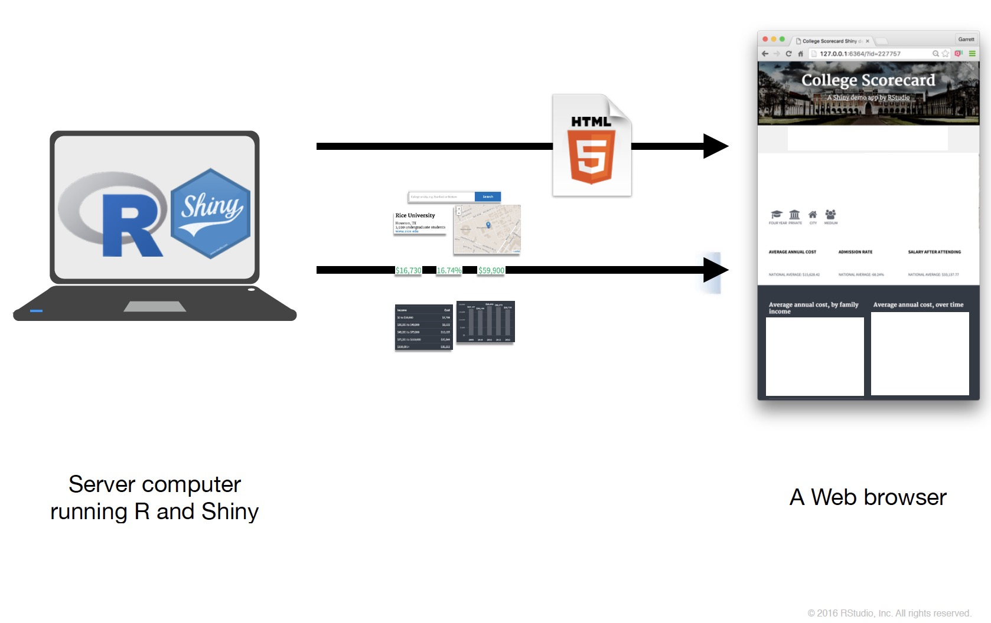
What goes into Shiny?
Shiny can be broken down into two pieces
Interface (user interface, ui)
Backend (server)
Shiny communicates between the Interface and Backend through two lists [the lists you’ve learned to use in R]
input
output

Slide 6
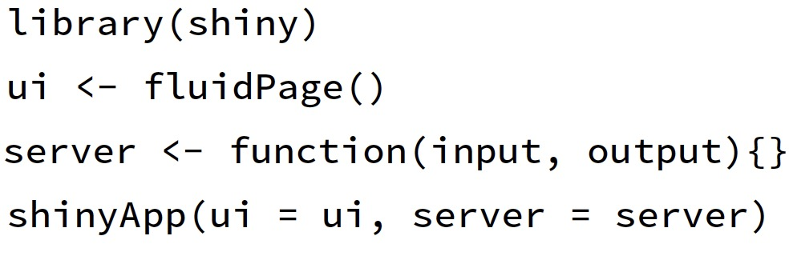
Template
Lets create an R app through RStudio.
It’ll come with a ton of stuff.
Lets remove it and replace with a minimalist product that will produce an empty (visually) webpage.

Slide 7
Just Do It.
The following can be put within a single file, eg. app.R the ui and server portions can be separated into two files:
ui.R and server.R
and run locally with the runApp function.

Slide 8
Assessment – run this

Slide 9
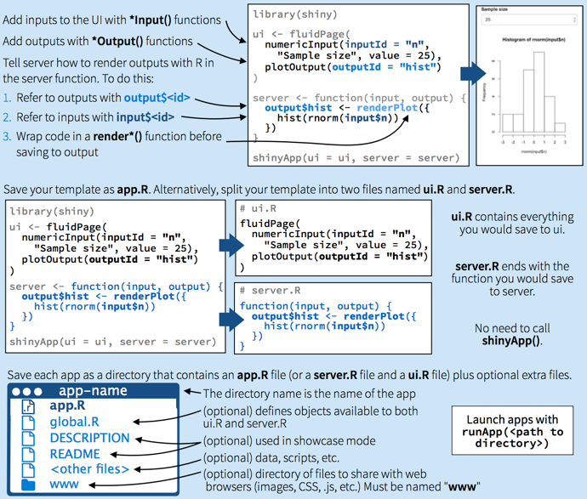
Overview - 1

Slide 10
Overview - 2

Slide 11
UI Breakdown

Slide 12
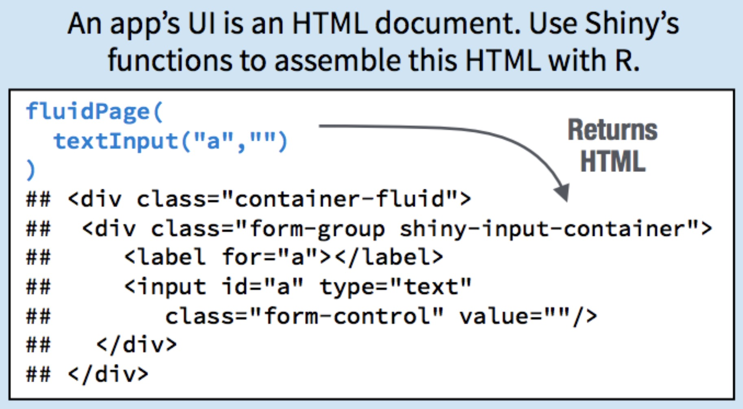
Digging a bit deeper.

Slide 13
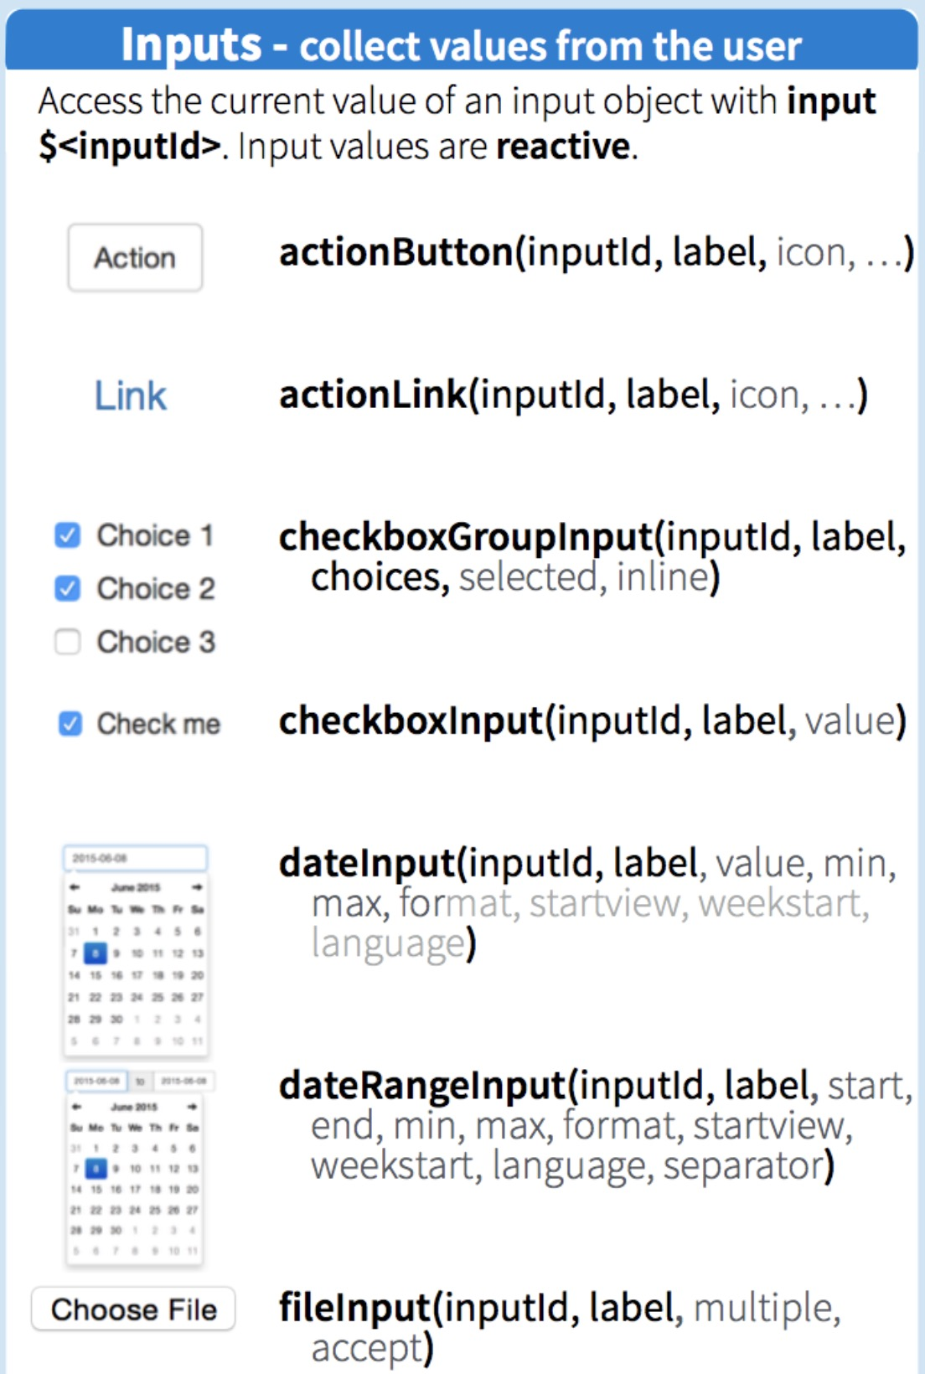
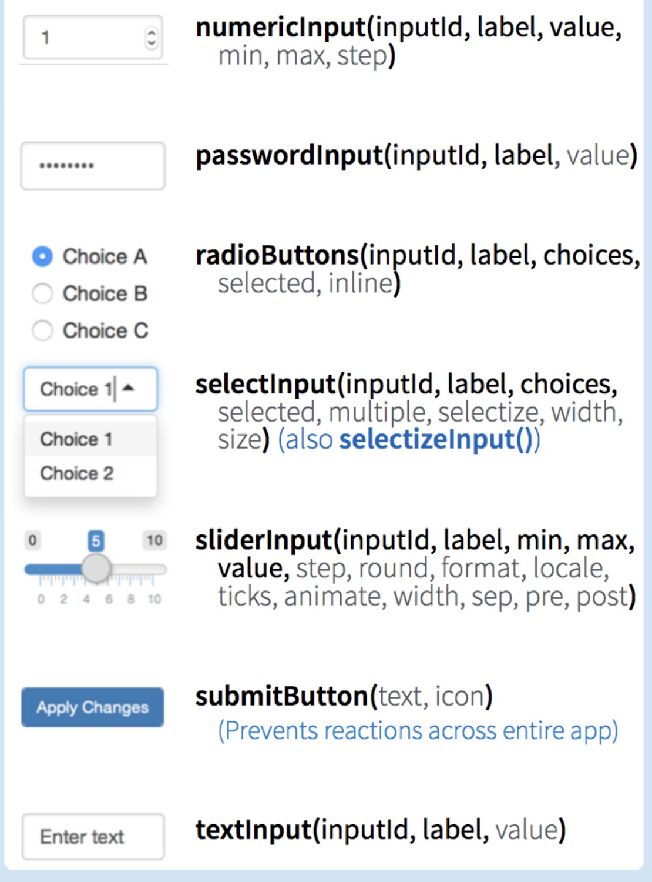
UI - Inputs
Inputs for the shiny app go within the ui component of the shiny app.
They create the sliders, radio buttons, and clickable values for the HTML user interface.
The values from the webpage (UI) are transferred to R in a list called ‘input’.
The values can be extracted and processed through R and are available as input$<inputID>.

Slide 14
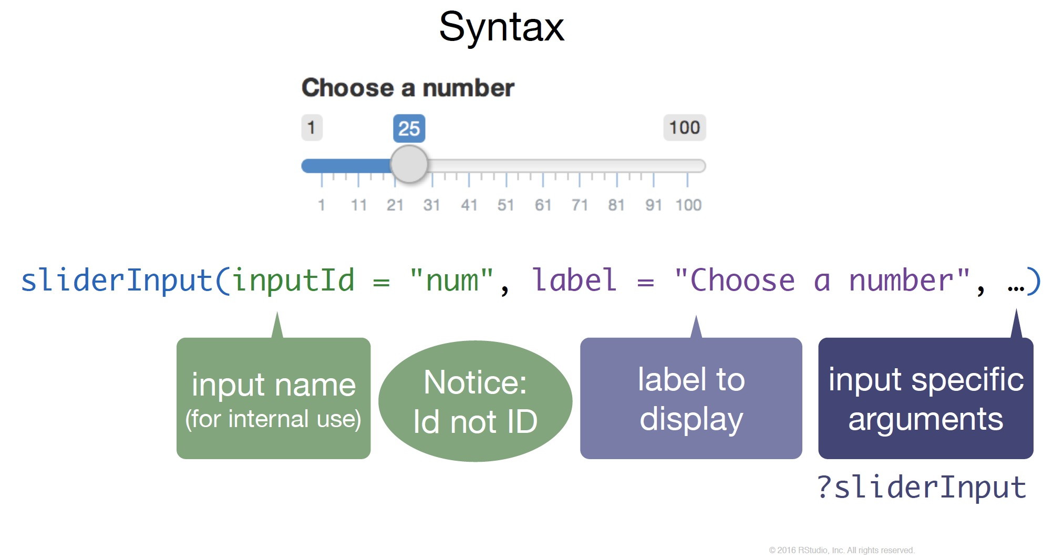

Slide 15
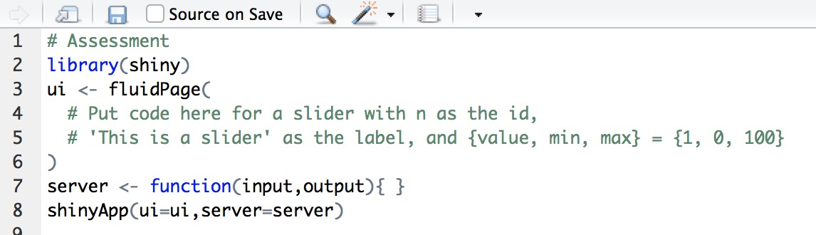
Assessment – UI inputs
Extend the basic template to create a sliderInput with a starting value of 1, min of 0 and max of 100.

Slide 16
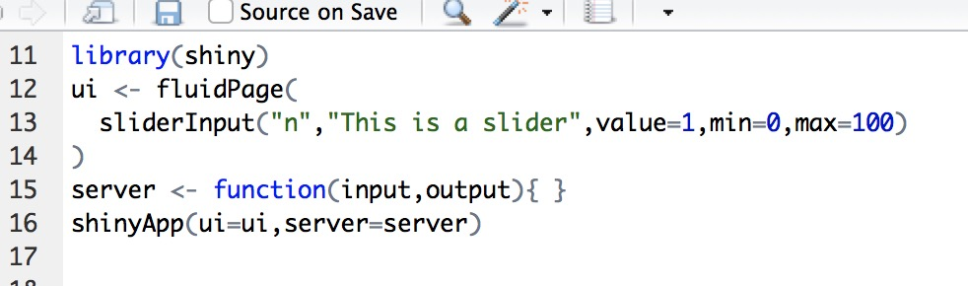
Solution
Extend the basic template to create a sliderInput.

Slide 17
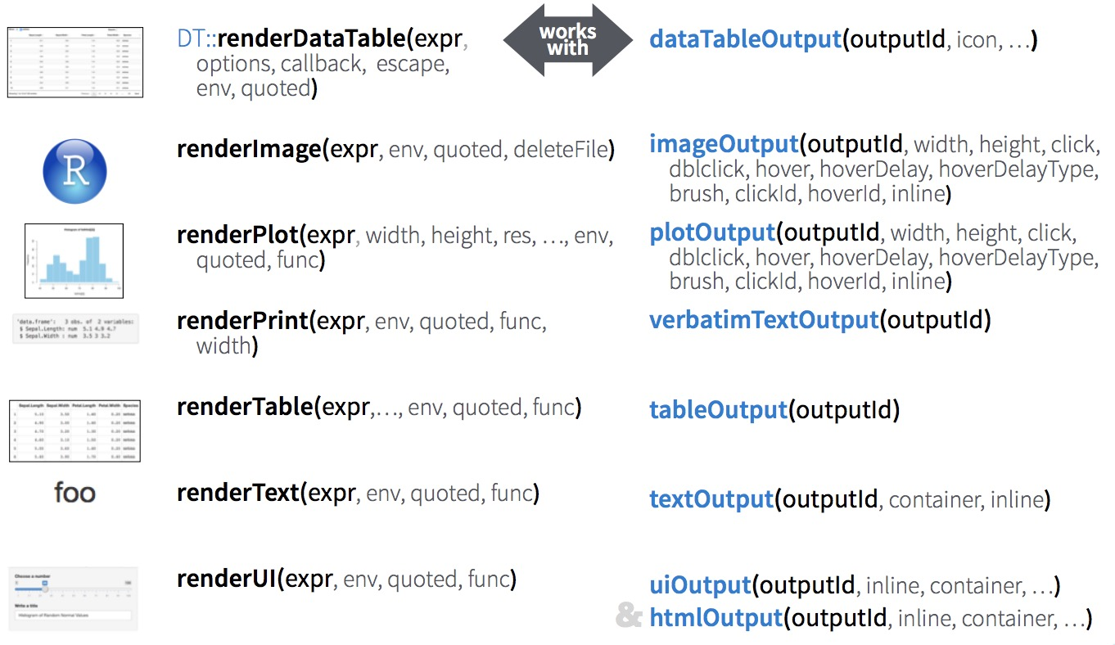
UI – Output
Put into server portion
Put into ui function
Other pieces go within the UI specifically to display the ‘server’ processed information.
The *Output functions take the output of functions rendered within the server. The rendered values are transferred from the server in output$<outputID> and rendered in the webpage (UI) using the *Output functions.

Slide 18
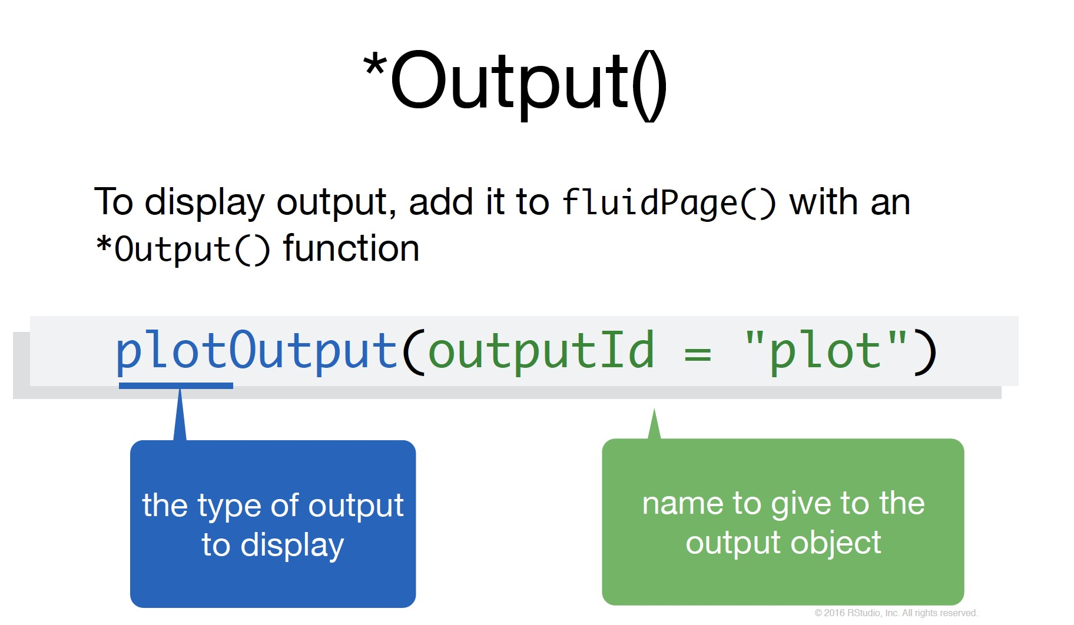

Slide 19
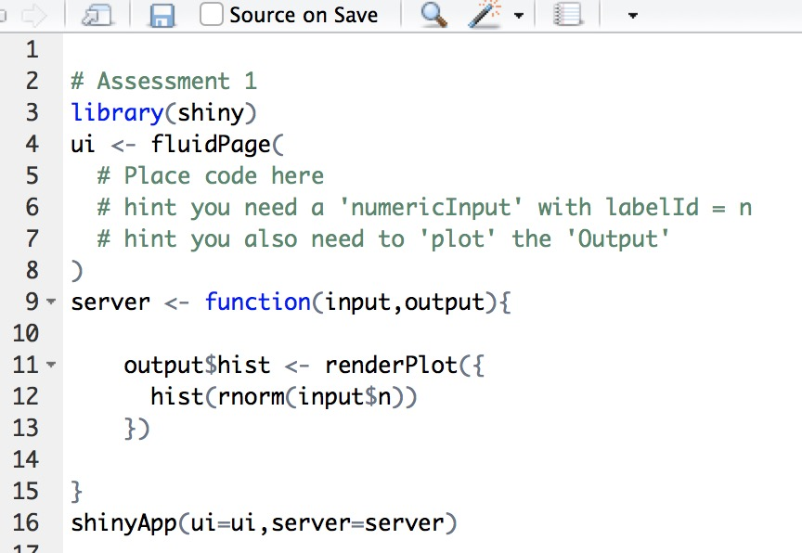
Assessment - UI output
Create a Shiny App using the following template to create a histogram of a user-defined number of draws from a normal distribution (or any distribution).
The general structure for the ui and server are in place as is the code required for plotting the histogram and drawing the ‘n’ draws.
In particular, you only need to prepare the plot. We only need to create a numericInput that will say how many draws to make from a distribution and a plotOutput that will plot the histogram.

Slide 20
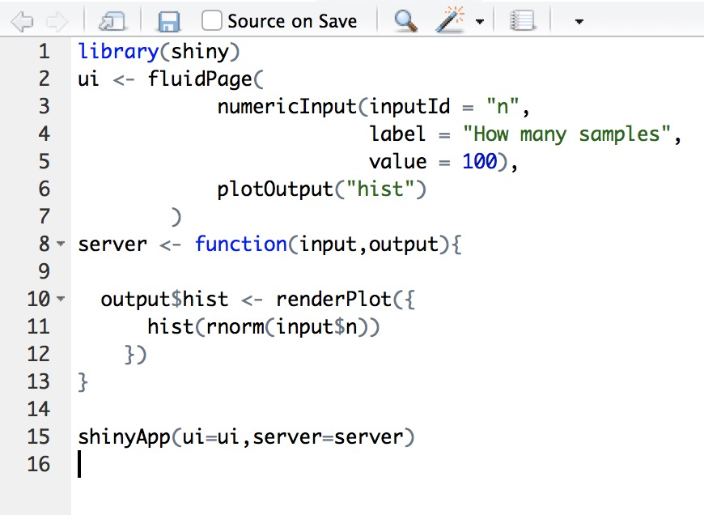
Solution
We added a numericInput to say how many draws to make from a distribution (eg. rnorm) and provided the hist function within output$hist the input$n normal distribution draws.

Slide 21
Server Breakdown

Slide 22
Server
Put into server portion
Put into ui portion
These pieces go within the server function and are the workhorse between taking the hard written functions and display.
The render functions perform the opposite task of the input functions and grab the output values and converts it into HTML code.
The rendered values are transferred from the server in output$<outputID> and rendered in the webpage (UI).

Slide 23
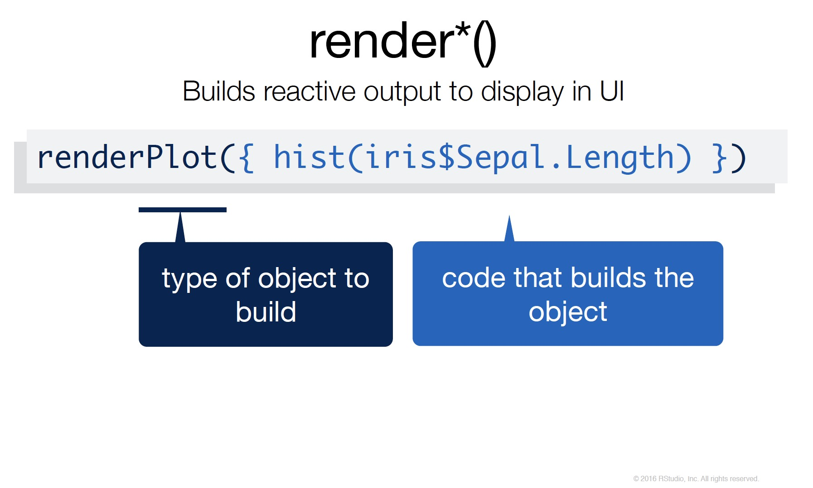

Slide 24
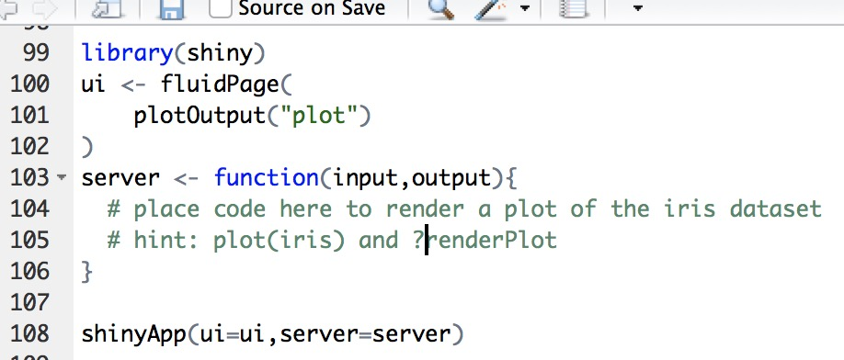
Assessment - Render output
Create a Shiny App using the following template to plot the iris dataset given:
The general structure for the ui and server are in place as is the code to plot the output from the server.
In particular, you only need to prepare and renderPlot the plot.

Slide 25
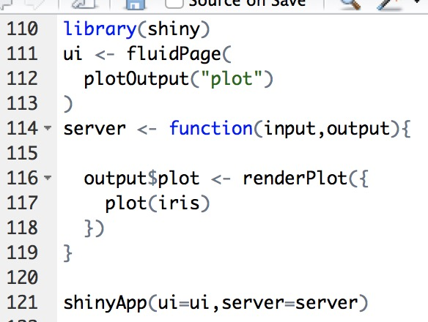
Solution
Create a Shiny App using the following template to plot the iris dataset given:
The general structure for the ui and server are in place as is the code to plot the output from the server.
In particular, you only need to prepare and renderPlot the plot.

Slide 26
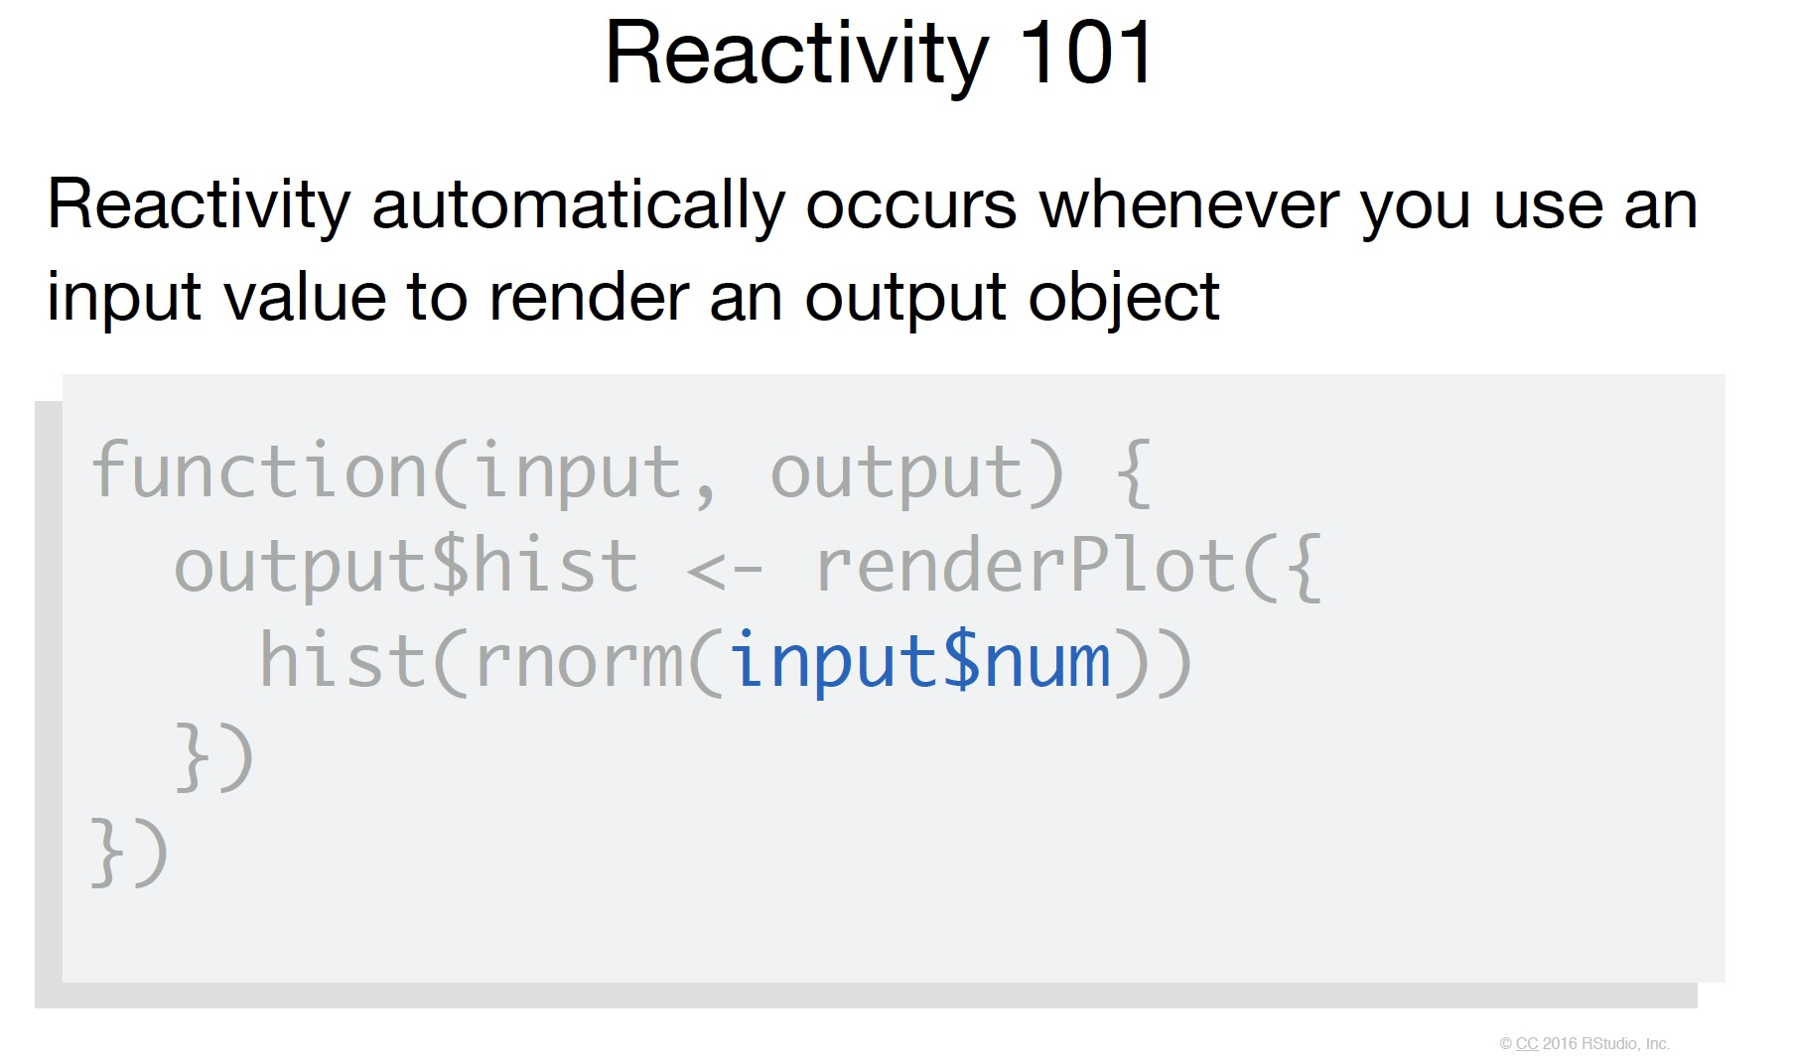
Reactivity
When the sliders, text, numeric, really any of the inputs are modified the functions within the server react to the changed input and re-render

Slide 27
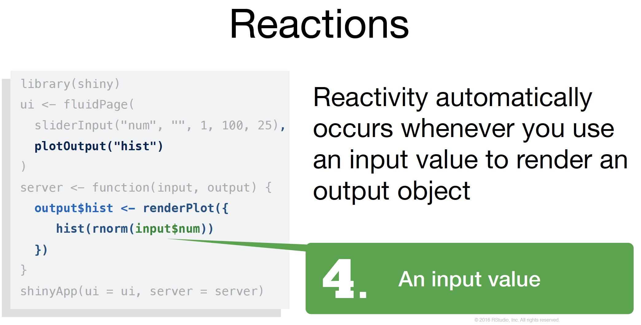
An input value

Slide 28
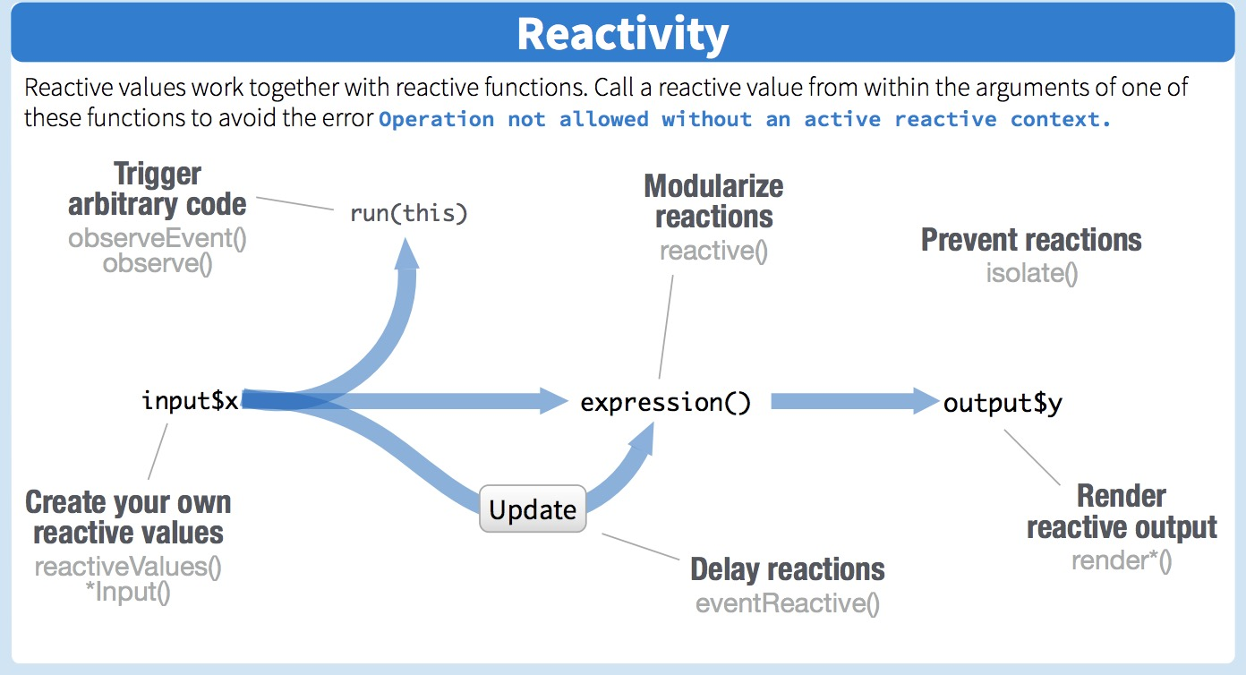

Slide 29
Reactivity
As your apps become more complicated, it can be useful to simplify your code and create reactive functions within the server to use across the multiple functions within the server.
For example, we can create reactive data to use within multiple functions

Slide 30
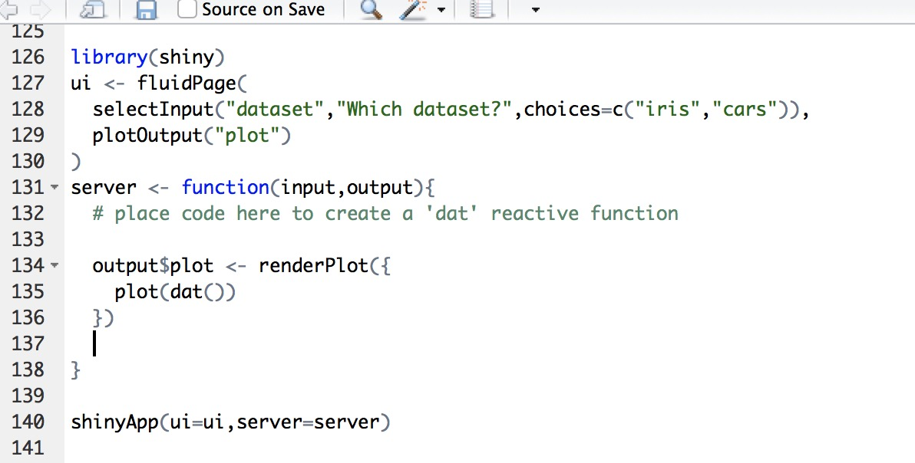
Assessment - Reactivity
Create a Shiny App using the following template to plot the iris dataset given:
The general structure for the ui and server are in place as is the code to plot the output from the server.
We want to display a plot for either the Iris or Car datasets depending on the selection

Slide 31
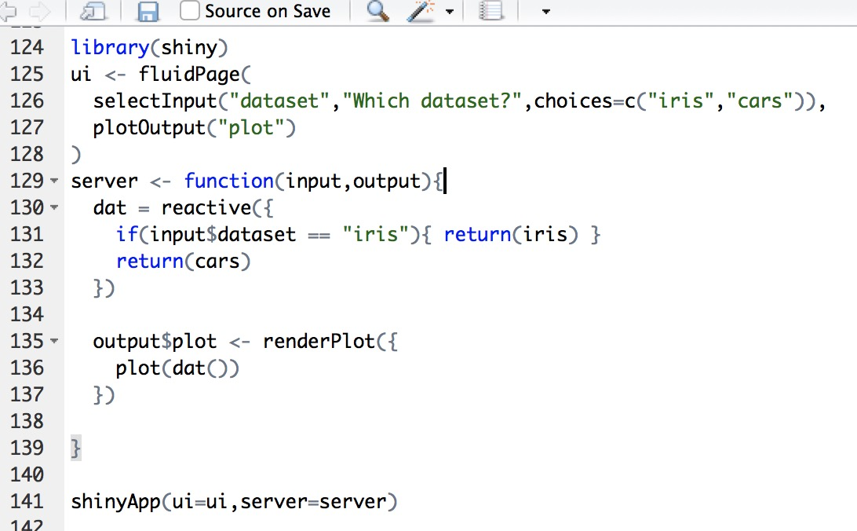
Solution
Create a Shiny App using the following template to plot the iris dataset given:
The general structure for the ui and server are in place as is the code to plot the output from the server.
We want to display a plot for either the Iris or Car datasets depending on the selection

Slide 32
Digging deeper.

Slide 33
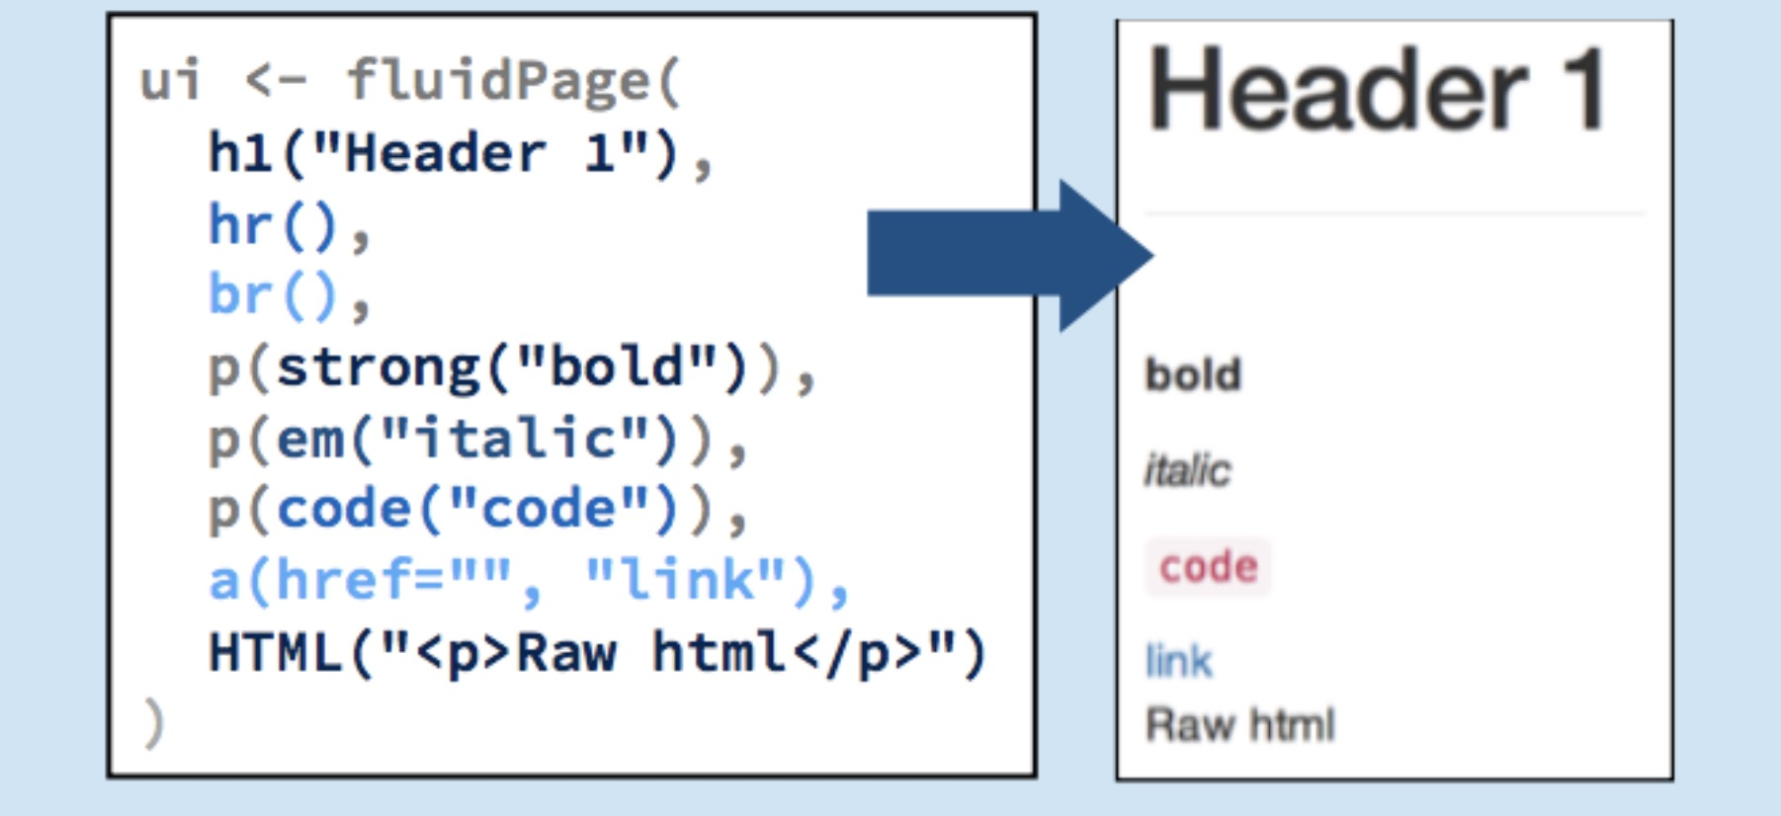
Digging a bit deeper.

Slide 34
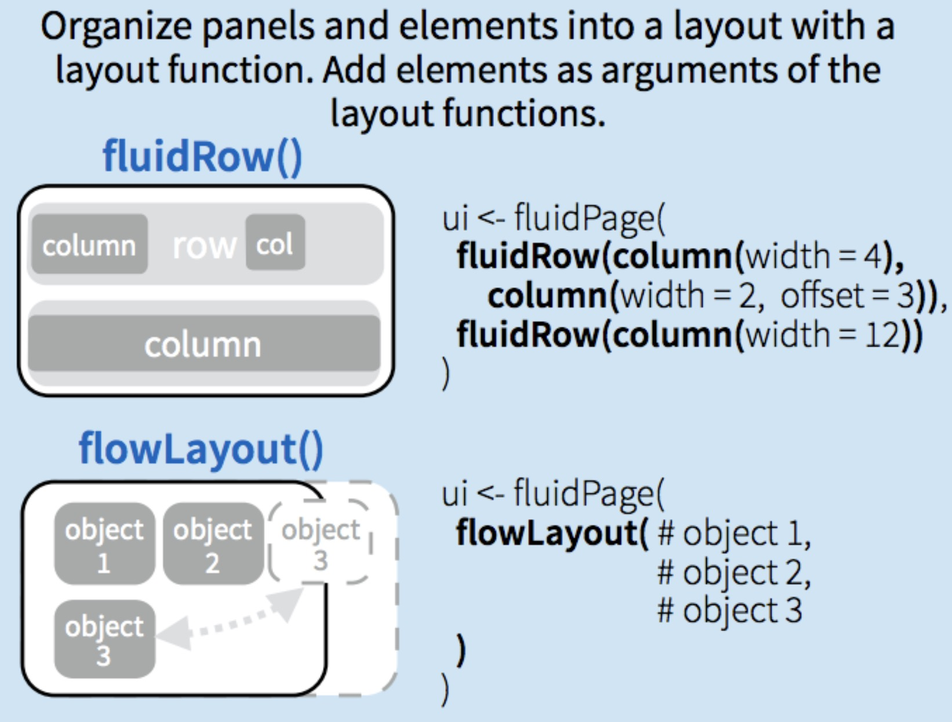
Digging a bit deeper.

Slide 35
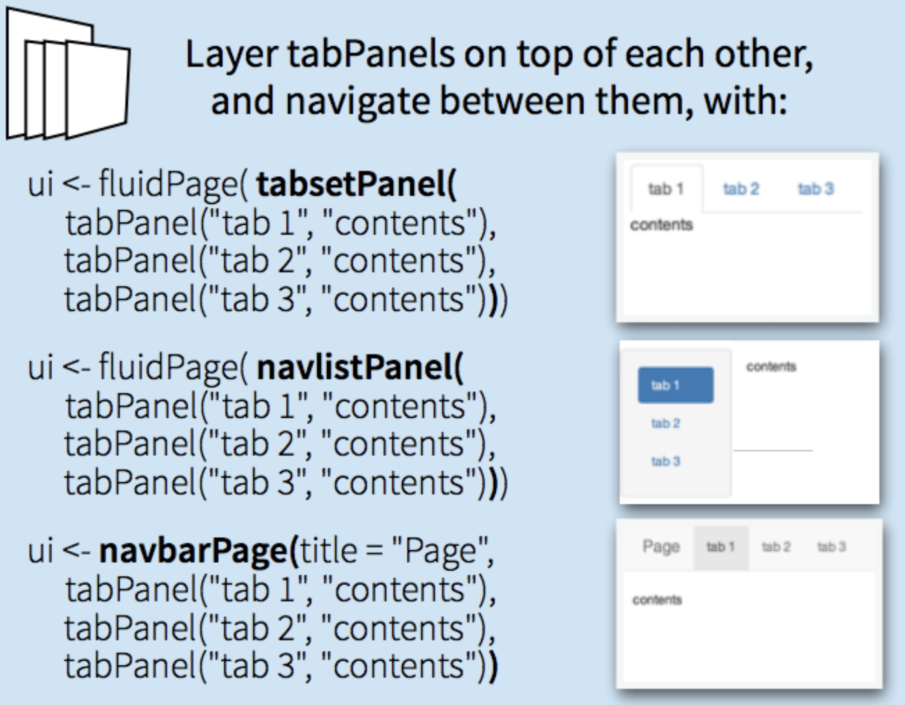
Digging a bit deeper.

Slide 36
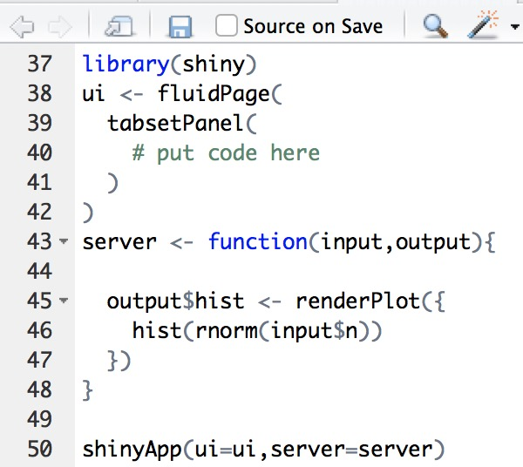
Assessment – tabs and other HTML
Create a Shiny App using the following template to create a ’tabsetPanel’ized app with tabPanels that will recreate the app we made earlier.
But this time, will make one tab for inputs (numericInput for our n observations) and another tab for the histogram output (using plotOutput)

Slide 37
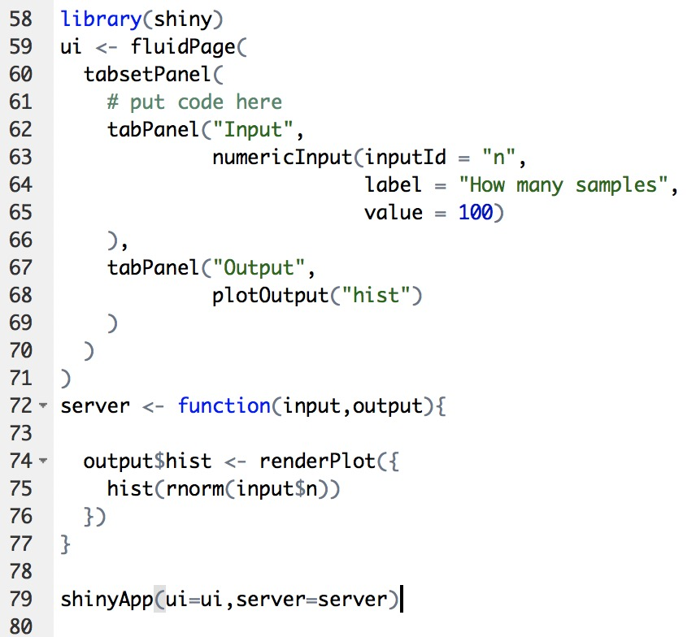
Solution
Create a Shiny App using the following template to create a ’tabsetPanel’ized app with tabPanels that will recreate the app we made earlier.
But this time, will make one tab for inputs (numericInput for our n observations) and another tab for the histogram output (using plotOutput)

Slide 38
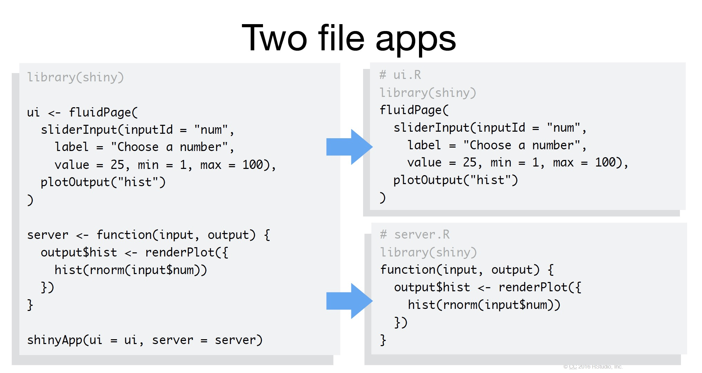
App design

Slide 39
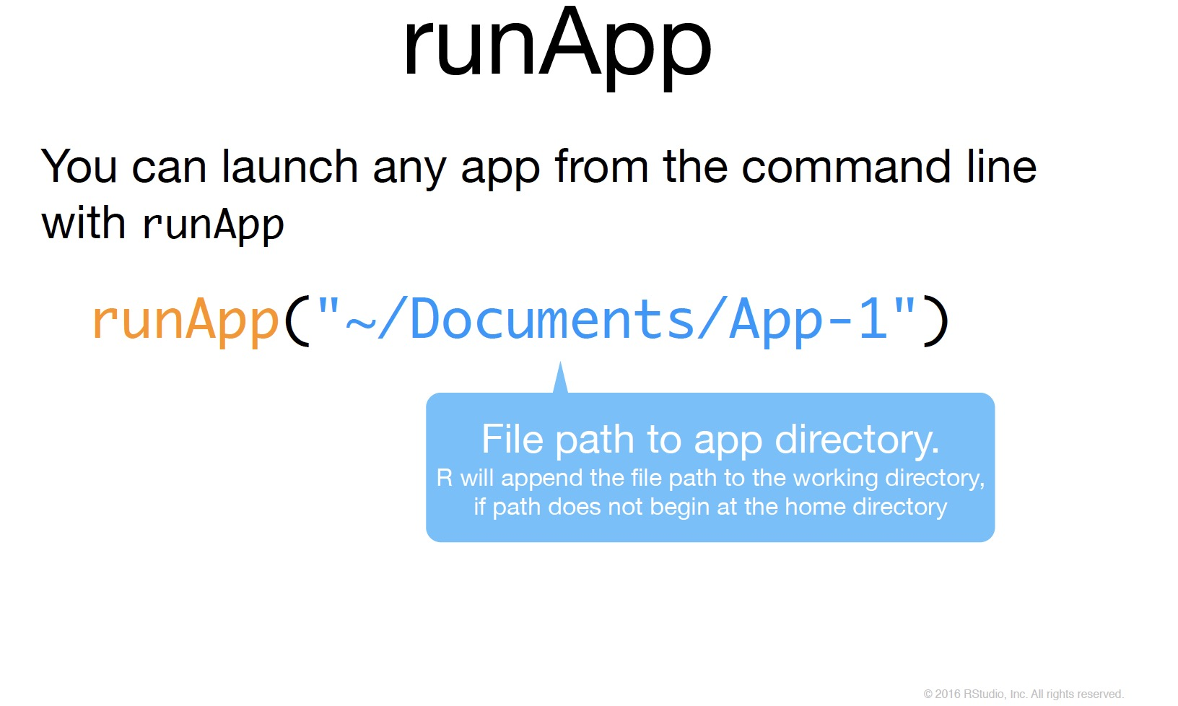
App design

Slide 40
Deploying your app
Shinyapps.io
Local shiny server

Slide 41
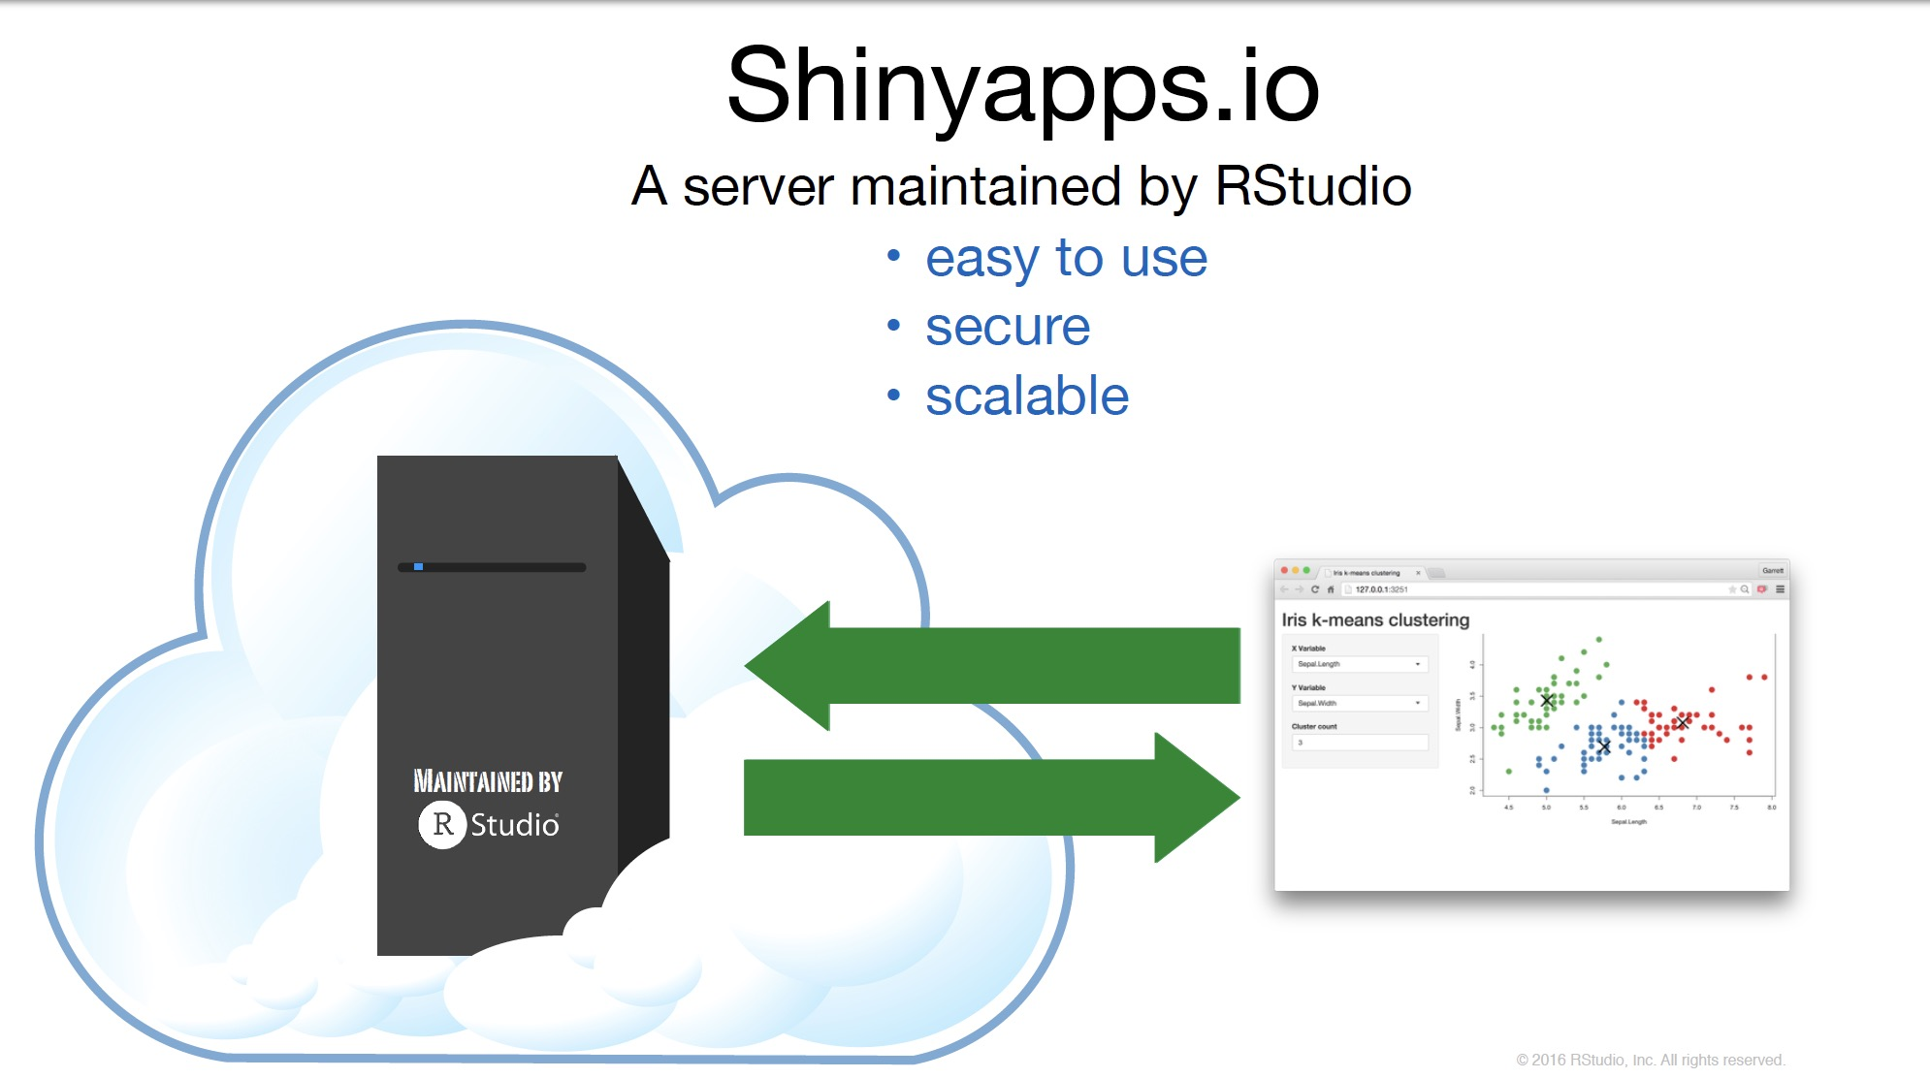

Slide 42
Example deployment workflow
Create cloud server instance
I prefer to use either Amazon Web Services (AWS) or DigitalOcean
Install Shiny Server [optionally Rstudio Server as well]
Go to Shiny App directory [default: /srv/shiny-server/shiny]
Make folder for your project along with server.R and ui.R
Optionally do this through Rstudio server and allow it to create the files and example scripts
Modify
Enjoy and Profit @ your-ip-address:3838/shiny/your-project-folder-name

Slide 43
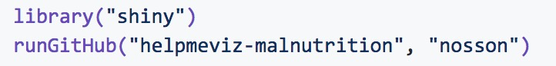
Example deployment workflow - 2
Can place shiny scripts into a github repository and anyone can run your apps locally with the runGithub function (or url and runUrl).
For example
https://github.com/jnpaulson/MSD1000
https://github.com/jnpaulson/helpmeviz-malnutrition

Slide 44
Example workflow - 3
Develop shiny code within an Rmarkdown file.
This allows for static components and then shiny/interactive components within the HTML produced document.
Download the example here
Note: requires no ShinyApp function call (nor ui / server function definitions)

Slide 45
Other shiny topics
Modules - https://shiny.rstudio.com/articles/modules.html
Reactive Inputs and other Reactivity - https://shiny.rstudio.com/articles/reactivity-overview.html

Slide 46
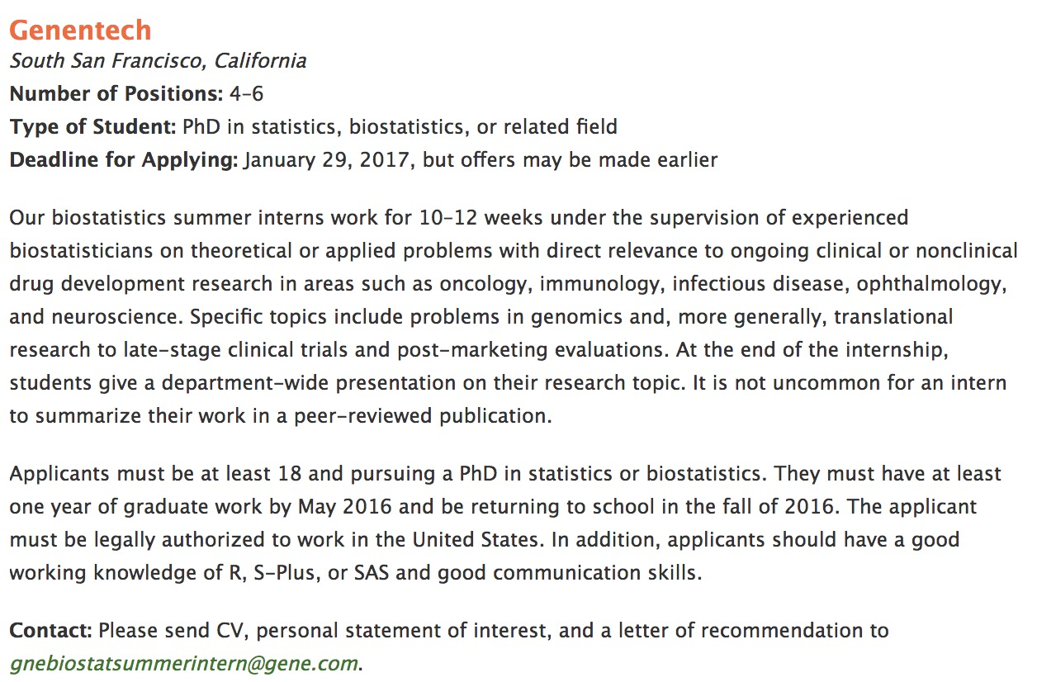
Internship @ Genentech (Summer 2017)

